Slide 1
healthcarers.sd.gov
HOTT Futures!

Slide 2
Department 1-Emergency Room
Emergency Medical Technician (EMT)
Phlebotomists/Medical Lab Technician
Radiology Technician
Medical/Clinical Lab Technologist
Department 2-Health Information
Health Information Technician
Medical Transcriptionist
Medical Assistant
Department 3-Surgery
Nurse Anesthetist
Surgeon
Surgical Technician
Department 4-Nursing Unit
Registered Nurse
Licensed Practical Nurse
Nursing Assistant (Aide)
Department 5-Ancillary Services
Pharmacist
Cardiovascular Technician
Dietitian
Department 6-Rehabilitation Services
Physical Therapist & Assistant
Occupational Therapist & Assistant
Respiratory Therapist
Department 7-Discharge Care
Medical & Health Care Administrator
Home Health Aide

Slide 4
Emergency Medical Technician EMT/Paramedic
TYPICAL TASKS
Drive emergency vehicles
Provide emergency care
Take the patient to a hospital
TRAINING – 1 YEAR
Training provided locally
Avera McKennan Hospital
Western Dakota Technical
Institute
Lake Area Technical Institute
University of Sioux Falls
SD MEDIAN HOURLY WAGE
$13.54
SD MEDIAN ANNUAL SALARY
$28,165
healthcareers.sd.gov

Slide 5
Clinical Lab Technician
TYPICAL TASKS
Performs routine blood tests
Prepares specimens for microscopic examination
Works in a clinical laboratory
TRAINING – 1 TO 2 YEARS
Lake Area Technical Institute, Watertown
Mitchell Technical Institute
SD MEDIAN HOURLY WAGE
$16.67
SD MEDIAN ANNUAL SALARY
$34,672
healthcareers.sd.gov

Slide 6
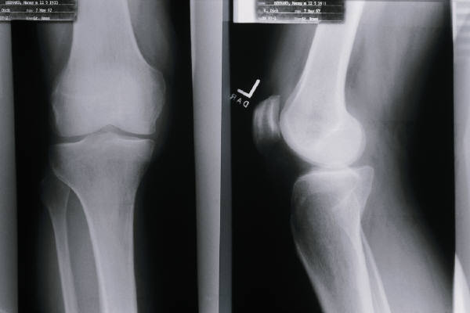
Radiology Technician
TYPICAL TASKS
Position patients
Performs radiologic exams using X ray and diagnostic imaging equipment
TRAINING – 2 or 4 YEARS
Avera McKennan Hospital, Sioux Falls
Avera Sacred Heart Hospital, Yankton
Mitchell Technical Institute, Mitchell
Mount Marty College, Yankton
Presentation College, Aberdeen
Sanford USD Medical Center, Sioux Falls
University of Sioux Falls, Sioux Falls
Rapid City Regional Hospital, Rapid City

Slide 7
Medical/Clinical Lab Scientist
TYPICAL TASKS
Examine and analyze body fluids and tissues
Type and cross match blood for transfusion
Use automated equipment and instruments
TRAINING – 2 OR 4 YEARS
Augustana College, Sioux Falls
Mount Marty College, Yankton
Northern State University, Aberdeen
South Dakota State University, Brookings
University of Sioux Falls, Sioux Falls
University of South Dakota, Vermillion
SD MEDIAN HOURLY WAGE
$24.19
SD MEDIAN ANNUAL SALARY
$50,321
healthcareers.sd.gov

Slide 8
Health Information Technician
TYPICAL TASKS
Organize patient records
Records information in the computer
Assigns a code to each diagnosis & procedure
TRAINING – 2 plus YEARS
Dakota State University, Madison
National American University, Ellsworth AFB,
Rapid City, Sioux Falls, Watertown
Southeast Technical Institute, Sioux Falls
University Center, Sioux Falls
SD MEDIAN HOURLY WAGE
$16.44
SD MEDIAN ANNUAL SALARY
$34,195
healthcareers.sd.gov

Slide 9
Medical Transcriptionist
TYPICAL TASKS
Listen to dictated recordings made by physicians
Type the text into a computer
Understand medical terms and treatments
TRAINING – 1 TO 2 YEARS
Presentation College, Aberdeen
Sinte Gleska University, Mission
The Right Turn, Inc., Pierre
Western Dakota Technical Institute, Rapid City
SD MEDIAN HOURLY WAGE
$14.13
SD MEDIAN ANNUAL SALARY
$29,381
healthcareers.sd.gov

Slide 10
Medical Assistant
TYPICAL TASKS
Measure patient’s blood pressure & other vitals
Prepare rooms for examination of patients
Answer the phone and schedule appointments
TRAINING – 1 OR 2 YEARS
Colorado Technical University, Sioux Falls
Globe University, Sioux Falls
Killian Community College, Sioux Falls
Lake Area Technical Institute, Watertown
Mitchell Technical Institute, Mitchell
National American University, Sioux Falls
Presentation College, Aberdeen
Western Dakota Technical Institute, Rapid City
SD MEDIAN HOURLY WAGE
$11.75
SD MEDIAN ANNUAL SALARY
$24,450
healthcareers.sd.gov

Slide 11
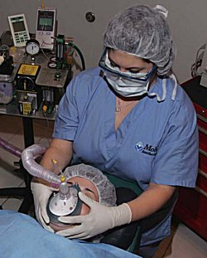
SD MEDIAN HOURLY WAGE
$75.53
SD MEDIAN ANNUAL SALARY
$157,097
Source: salary.com
Nurse Anesthetist
TYPICAL TASKS
Administer drugs during surgery
Monitor the patient’s vital signs
TRAINING – 5 YEARS
Mount Marty College, Yankton
healthcareers.sd.gov

Slide 12
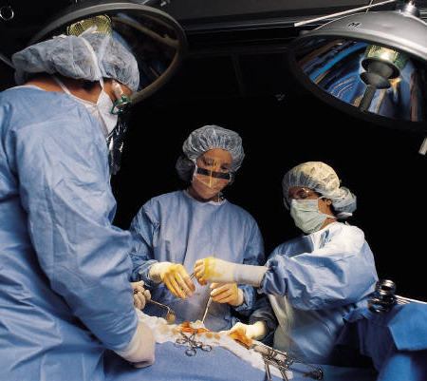
Surgeon
TYPICAL TASKS
Perform surgical operations
Operate instruments
Reviews patient history & diagnostic test results & confirms need for surgery
TRAINING – 11 TO 16 YEARS
University of South Dakota, Vermillion
SD MEDIAN HOURLY WAGE
$109.38
SD MEDIAN ANNUAL SALARY
$227,502
healthcareers.sd.gov

Slide 13
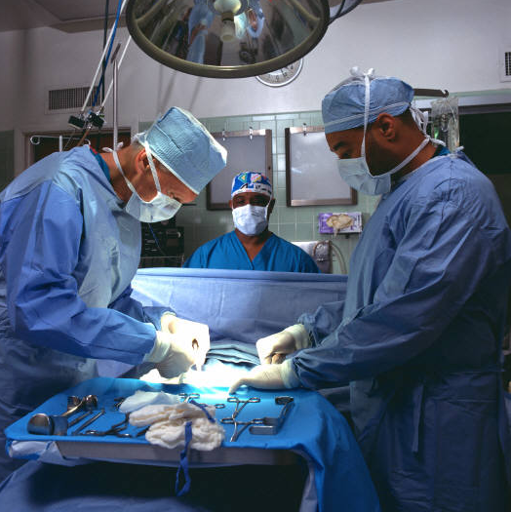
Surgical Technologists
TYPICAL TASKS
Assist in preparing and moving patients
Set up and pass instruments during the surgery
Assist in cleaning the operating room and used instruments
TRAINING – 1 OR 2 YEARS
Presentation College, Aberdeen
Southeast Technical Institute, Sioux Falls
Western Dakota Technical Institute, Rapid City
SD MEDIAN HOURLY WAGE
$17.59
SD MEDIAN ANNUAL SALARY
$36,582
healthcareers.sd.gov

Slide 14
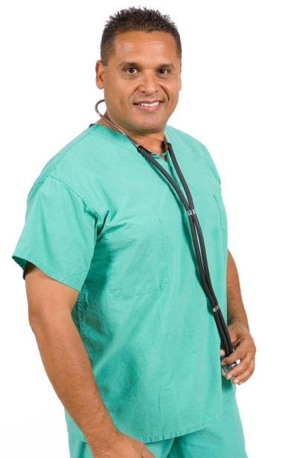
Registered Nurse
TYPICAL TASKS
Listen to lung & heart sounds
Observe & record patients’ symptoms
Teach patients & families about health care
Administer medications
TRAINING – 2 OR 4 YEARS
Augustana College, Sioux Falls
Capital University Center, Pierre
Dakota Wesleyan University, Mitchell
Mount Marty College, Yankton
National American University, Sioux Falls
Oglala Lakota College, Kyle
Presentation College, Aberdeen
SDSU, Brookings
USD, Vermillion
University Center, Sioux Falls
University of Sioux Falls, Sioux Falls
SD MEDIAN HOURLY WAGE
$26.87
SD MEDIAN ANNUAL SALARY
$55,886
healthcareers.sd.gov

Slide 15
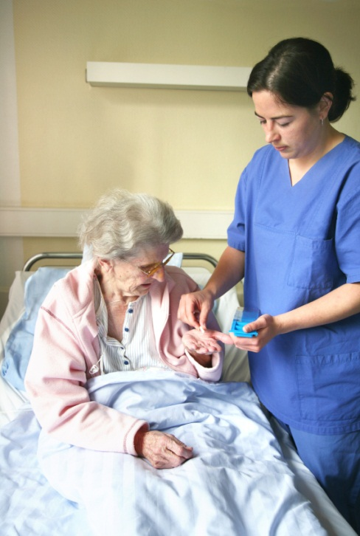
Licensed Practical Nurse
TYPICAL TASKS
Administer medications orally & by injection
Collect samples such as urine, blood & sputum
Help patients turn in bed, stand & walk
TRAINING – 1 YEAR
Capital University Center, Pierre
Lake Area Technical Institute, Watertown
Mount Marty College, Yankton
Sinte Gleska University, Mission
Southeast Technical Institute, Sioux Falls
Western Dakota Technical Institute, Rapid City
Sisseton Wahpeton College, Sisseton
SD MEDIAN HOURLY WAGE
$16.35
SD MEDIAN ANNUAL SALARY
$34,008
healthcareers.sd.gov

Slide 16
Nurse Assistant
TYPICAL TASKS
Assist with dressing changes
Answer patients’ call lights & serve meals
Help patients dress & bathe
TRAINING – LESS THAN ONE YEAR
Training provided locally
SD MEDIAN HOURLY WAGE
$11.05
SD MEDIAN ANNUAL SALARY
$22,974
healthcareers.sd.gov

Slide 17
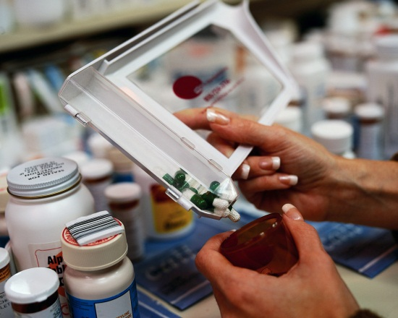
Pharmacist
TYPICAL TASKS
Prepare and give out drugs prescribed by doctors
Warn patients about side effects
Understand the use and effects of medications
TRAINING – 6 YEARS
South Dakota State University, Brookings
SD MEDIAN HOURLY WAGE
$47.81
SD MEDIAN ANNUAL SALARY
$99,443
healthcareers.sd.gov

Slide 18
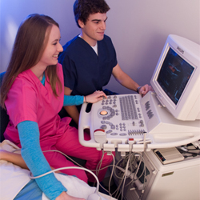
Cardiovascular Technician
TYPICAL TASKS
Operate equipment used in diagnosis and treatment of heart problems
Assist physician in treatment of blockages of blood vessels
Prepare and monitor the patient
TRAINING – 2 YEARS
Southeast Technical Institute, Sioux Falls
SD MEDIAN HOURLY WAGE
$22.93
SD MEDIAN ANNUAL SALARY
$47,694
healthcareers.sd.gov

Slide 19
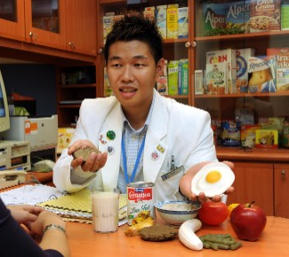
Dietitian/Nutritionist
TYPICAL TASKS
Plan and supervise nutrition programs
Dietary counseling to treat illnesses
Assess patients’ nutritional needs
TRAINING – 5 YEARS
South Dakota State University, Brookings
SD MEDIAN HOURLY WAGE
$23.94
SD MEDIAN ANNUAL SALARY
$49,802
healthcareers.sd.gov

Slide 20
Physical Therapist
TYPICAL TASKS
Evaluate/assess needs of patients
Develop treatment plan to promote physical function
Range of Motion exercises
TRAINING – 7 YEARS
University of South Dakota, Vermillion
Physical Therapist Assistant
TYPICAL TASKS
Help patients restore physical functions
Range of Motion exercises
Instruct patients on the use of crutches & walkers
TRAINING – 2 YEARS
Lake Area Technical Institute, Watertown
SD MEDIAN HOURLY WAGE
$33.32
SD MEDIAN ANNUAL SALARY
$69,302
healthcareers.sd.gov

Slide 21
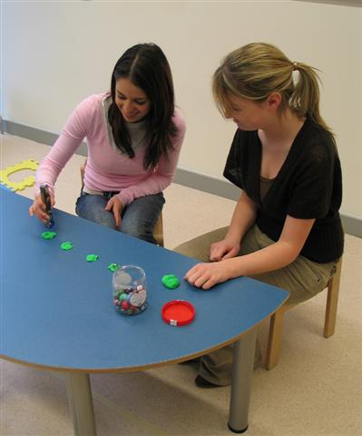
Occupational Therapist
TYPICAL TASKS
Plans and conducts therapy programs for patients impaired by illness or injury
Help patients develop, regain or maintain their ability to perform living activities
Studies and evaluates patients’ activities and programs
TRAINING – 6+ YEARS
University of South Dakota,Vermillion
Occupational Therapy Assistant
TYPICAL TASKS
Treat people impaired by illness or injury
Help patients with daily living skills
Help patients learn tasks needed for work
TRAINING – 2 YEARS
Lake Area Technical Institute, Watertown
SD MEDIAN HOURLY WAGE
$29.44
SD MEDIAN ANNUAL SALARY
$61,229
SD MEDIAN HOURLY WAGE
$16.31
SD MEDIAN ANNUAL SALARY
$33,915

Slide 22
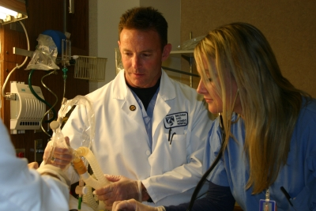
Respiratory Therapist
TYPICAL TASKS
Assists in the diagnosis, treatment, and management of patients with respiratory problems and disorders.
Measures the capacity of the patient’s lungs
Connect ventilators to patients that cannot breath
TRAINING – 2 OR 4 YEARS
Dakota State University, Madison
University Center, Sioux Falls
SD MEDIAN HOURLY WAGE
$23.14
SD MEDIAN ANNUAL SALARY
$48,129
healthcareers.sd.gov

Slide 23
Medical & Health Service Manager
TYPICAL TASKS
Plan, direct, coordinate & supervise the delivery of
healthcare
Direct employees
Work with finances of the business
TRAINING – 4 PLUS YEARS
Colorado Technical Institute, Sioux Falls
Globe University, Sioux Falls
National American University, Ellsworth AFB, Rapid City, Sioux Falls, Watertown
SD MEDIAN HOURLY WAGE
$42.17
SD MEDIAN ANNUAL SALARY
$87,714
healthcareers.sd.gov

Slide 24
Home Health Aide
TYPICAL TASKS
Check the patient’s pulse, temperature & breathing
Help patients with simple exercises
Assist patients with bathing, grooming, toileting & nutrition
TRAINING – 1 YEAR
On the job
SD MEDIAN HOURLY WAGE
$11.71
SD MEDIAN ANNUAL SALARY
$24,361
healthcareers.sd.gov

Slide 25
“Other” Jobs at Health Care Facilities
Accountant
Accounting Clerk
Admitting Clerk
Application Support Specialist
Building Maintenance Technician
Business Office Clerk
Cashier
Central Stores Aide
Chaplain
Collection Specialist
Computer Operator
Cook
Custodian
Data Processing
Electrician
File Clerk
Food Service Worker
Gift Shop
Help Desk Support
Housekeeping
Human Resources
HVAC
Information Systems Assistant
Insurance Claims Clerk
Inventory Control Clerk
Laundry
Marketing
Mechanic
Medicare Insurance Clerk
Network Engineer
Payroll/Benefits Representative
Physician Recruitment
Plumber
Receptionist
Secretary
Shipping and Receiving Clerk
Storeroom Clerk
Systems Analyst

Slide 26
Notes
Source for Salary Data: South Dakota Labor Market Information Center, unless otherwise indicated
Source for Training Data: “South Dakota Training in Healthcare”. This document is updated periodically throughout the year. For most up-to-date information, contact schools directly.
This presentation was last updated 7/1/11

